Slide 2
Hands-On Session: PIRCHE & HLA-EMMA

Slide 3
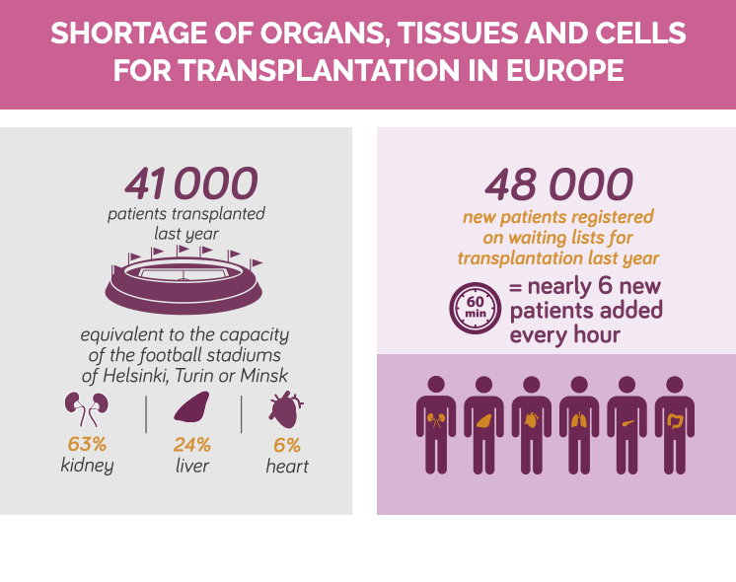
Despite all efforts ….
https://www.coe.int/en/web/human-rights-channel/organ-donation

Slide 4
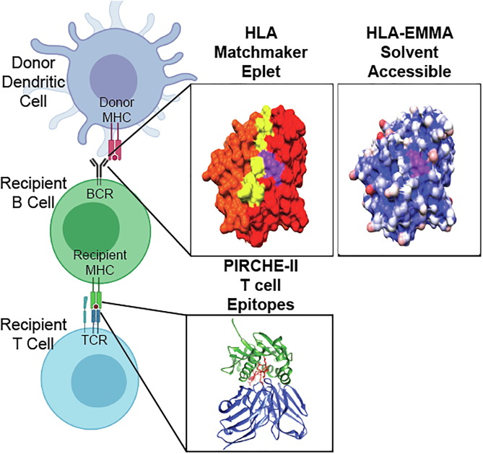
Predicting AB response to MISMATCH HLA

Slide 5
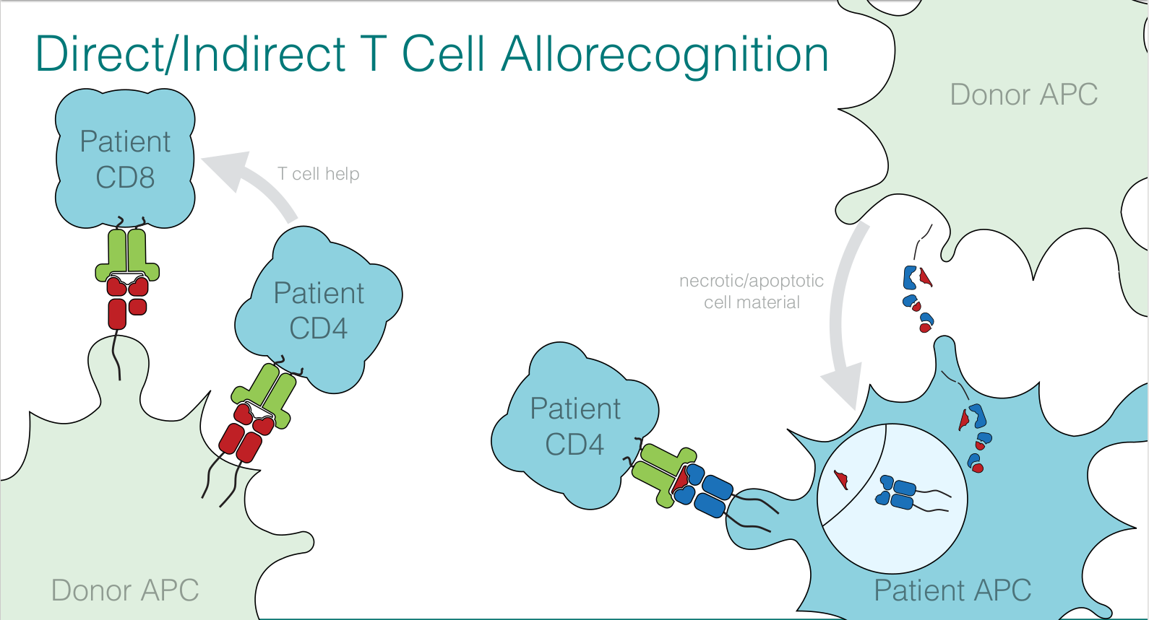
Direct/Indirect T cell recognition of Mismatched HLA
Red=Mismatching HLA

Slide 6
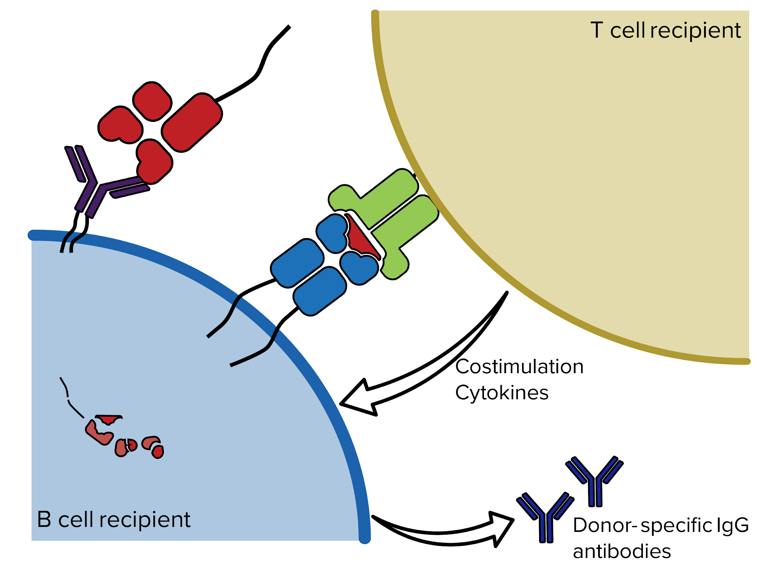

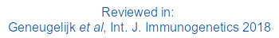

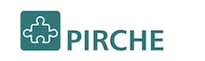
PIRCHE Algortihm to predict T cell Epitopes
PIRCHE = Predicted Indirectly Recognizable HLA Epitopes
→ predicts epitopes due to HLA mismatches
(peptides that differ between host and graft) prior to transplantation
→ high PIRCHE numbers = high risk for alloreactivity
→ In this Tutorial we will focus on PIRCHE-II
Matthias Niemann
Dr. Eric Spierings

Slide 7




STEP 1
Which parts of the HLA mismatch are not present in the HLA of the recipient?
Donor
Recipient
=
🡺
Self peptide
≠
🡺
Non-self peptide

Slide 8
STEP II
Recipient
HLA class II
Donor
Recipient
?
Which parts of the HLA mismatch are not present in the HLA of the Recipient?
Check binding of these parts to recipient HLA class II (NetMHCIIpan).
=
🡺
Self peptide
≠
🡺
Non-self peptide

Slide 9
Functionality of the PIRCHE Program
Available via a web server: pirche.com
Indirect presentation by HLA class I and class II can be done
Available for all populations by including all known HLA alleles
Applicable for analyses of cohorts by incorporating batch analysis option
Providing both the number as well as the sequence of possible T cell epitopes

